Slide 1

GROUP 11
Melis
Florentine
Eden
Rafael
Aurelien
Sonya
Project 1-1
Pentominoes

Slide 2
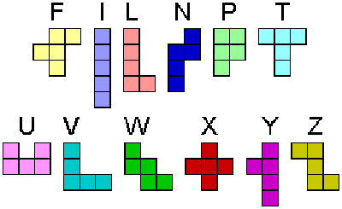
The Problem
Can a given set of pentominoes cover a rectangle grid of a given size ?
Its Implications
Is it possible to use «recursion»?
If there is, which is the most efficient?

Slide 3
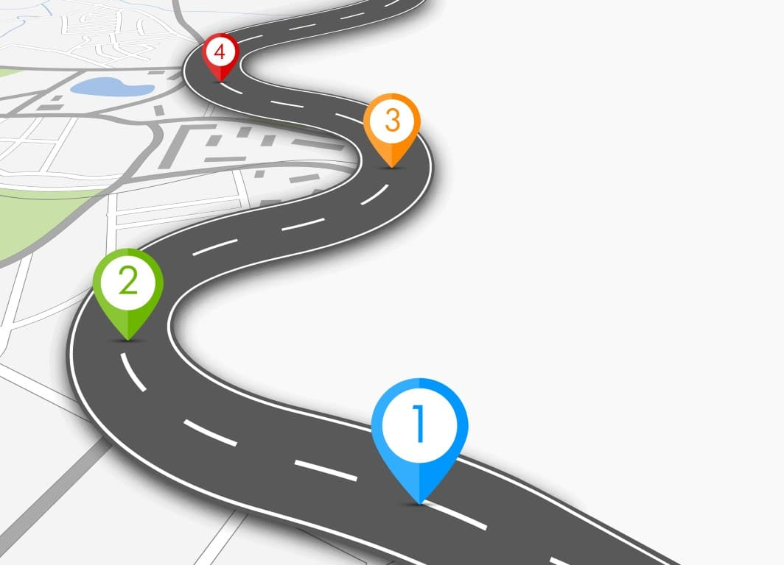
The Solution(s)
Opening :
-RoadMap
Development:
Our Discovery
Additional functions
-Recursive algorithm 1
-Basic search
-Recursive algorithm 2
-Recursive algorithm 3
Closing :
-Answer & Efficiency
-Overview on Who did what

Slide 4

Our Discovery : The first Functions
Filling the missing pentominoes
0 : Meaning « empty space »
1 : Space filled by a part of the pentomino
CheckifFilled function:
For loop to go through the Grid horizontally
Nested For loop to go through the Grid vertically and cover it entirely.
Condition to test if there is a blank space :
If field[i][j] == -1
If there is : False , else : True.
CheckIfFilled Function
Checks if the rectangle grid is filled or if there is empty space.
Line 141 , Search.Java

Slide 5


Our Discovery : The Files
UI.java : User Interface to represent the Grid and our pentominoes ( 2D )
PentominoBuilder : Creation of Pentomino and its attributes ( Rotation , Flip , Size )
Search : File containing the algorithm(s) to solve the problem
PentominoDatabase : Extracts Data from the CSV file to use it in the code
CSV file : Represents all possible orientations (Rotation/Flip) of all pentominoes

Slide 6

Following Up:
Example : X pentomino
isEqual Function :
Checks if two matrices (Pentominoes) are equal , if they are , it removes one of them from the CSV file to gain efficiency.
X pentomino :
All permutations are equal to themselves.

Slide 7
Additional Functions
CloneTwoDimensional :
CheckIfFits :
Checks if it is possible to fit a given pentomino into a given place in the field. Basic function to solve the problem
Clones a 2D array (pentomino) 🡪 very useful in the recursive algorithm we are using.

Slide 8
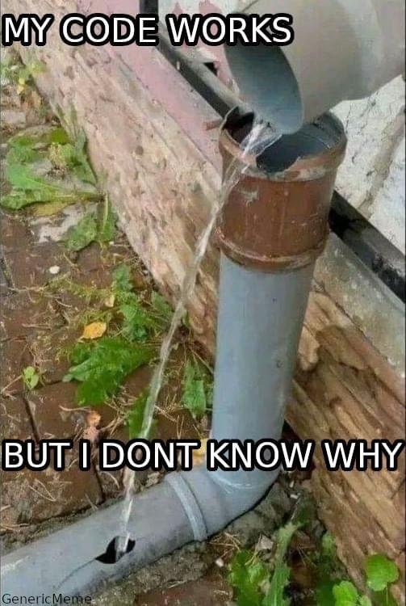
Recursive Algorithm 1
Base case :
If the whole field is filled, we found a solution
Recursive Part :
Check every cell of field
Create 2D array of every possible pentominoes and their mutations
For every pentomino, check if it fits in the grid
If YES: clone field and add pentomino in cloned version
Make a copy of an array containing all pentominoes 🡪 remove the used one
Call the method again with the cloned field and the new array of pentominoes

Slide 9
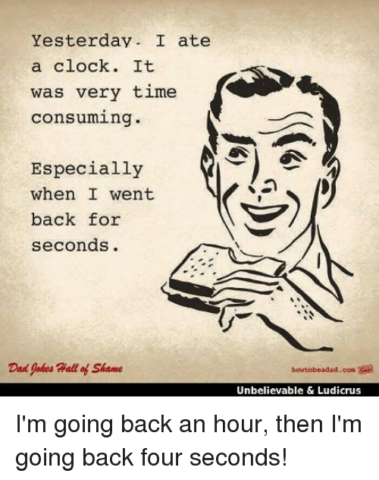
Basic Search Algorithm
A few facts on this algorithm :
The algorithm :
Very time consuming
Not a brute-force algorithm 🡪 random search
Takes a field (matrix) as a parameter, its goal is to fill it
The field is «emptied» : field[i][j] = -1;
Random pentomino chosen put in the field : 2 cases : X and Y
X : either it fits perfectly , either it doesn’t or there are multiple ways of putting it
Y : either it fits perfectly , either it doesn’t or there are multiple ways of putting it
This process is repeated a number of times equal to the length of the field
When the field is full , program stops or it continues to search (while loop)until it finds

Slide 10
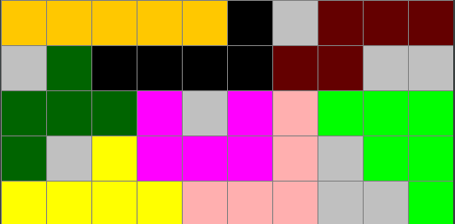
Pruning Algorithm 1 : check one empty square
Goal of this pruning algorithm
The Algorithm
Stop trying to find a solution in a branch where there is one empty square surrounded by non-empty cells
loop through field searching for empty spaces
check if the boxes next to it are empty ( x+1, x-1, y+1, y-1)
remember all the edge cases and make exceptions

Slide 11
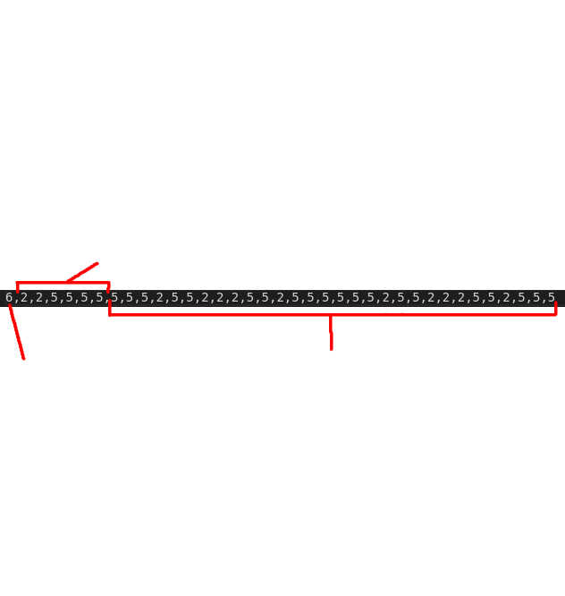
Effiency improvement: Save.java File
Save.java : A saving program
How it proceeds to read and save :
Goes through each line of the CSV file and changes the String in those lines into a list of numbers.
compare input against pentominoes
Pentominoes are saved with their corresponding solution
in a one line string with a header of Pentominoes
Goal : Save solutions depending on the pentominoes to avoid searching them later if we encounter the same problem
🡪 Saves a lot of time
🡪 Trades CPU time for disk space
Pentominoes
Number of pentominoes
Solution array

Slide 12
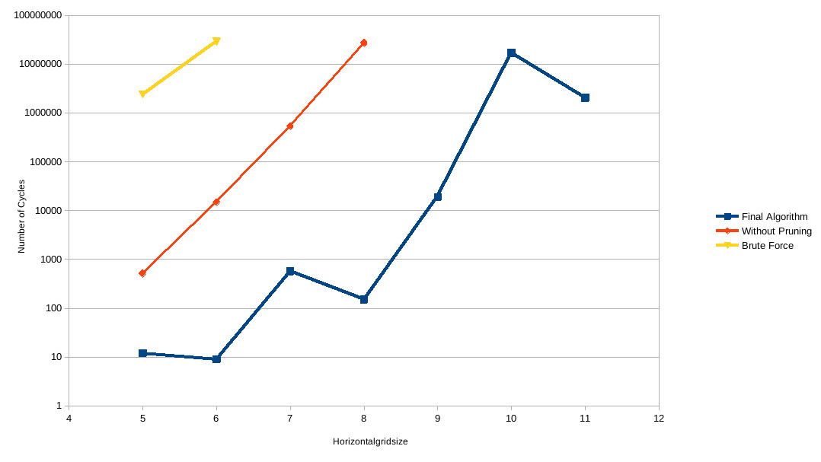
The Answer & Efficiency
Our Final Results
Results
Missing solutions
Further improvements
comparing to other programs

Slide 13


Overview of Who did What
Thank you for listening !
 | Monday Full Coding session | Tuesday Coding on recursion + Start of outline | Wednesday End of recursion , focus on efficiency + PPT | Thursday Efficiency , Understanding, Presentation +Pruning
Aurelien | Code | Presentation | Presentation (Chair) | Presentation Explanations
Melis | Code | Code | Code (Secretary) | Code
Rafael | Code | Code | Code | Code
Eden | Code (Chair) | Code | Code | Code
Sonya | Code | Code | Code | Code presentation
Florentine | Code (Secretary) | Code | Code | Code + Read me File

Slide 14
Q&A

Slide 15
THANK YOU

